Slide 1

SOFTWARE DEVELOPMENT PROJECT
NFT MARKETPLACE
By - Sakshi Zod
Guide :- Mrs. Deepali Joshi

Slide 2

Aim & Objective Problem Statement
Scope and Feasibility of Project Tools Used
Literature Review Proposed Diagram References
Table of Contents

Slide 3
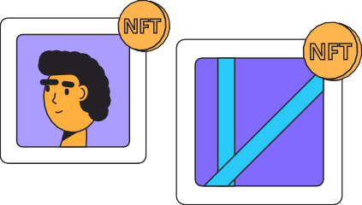





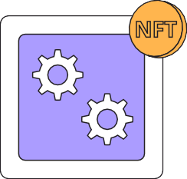
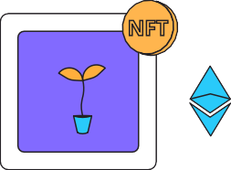

Aim & Objective
The aim of the project is to build a NFT marketplace where one can make its collection and buy NFT.
The objective of the project is to build a NFT marketplace using the Metamask as the cryptocurrency wallet based on the Ethereum Blockchain.

Slide 4

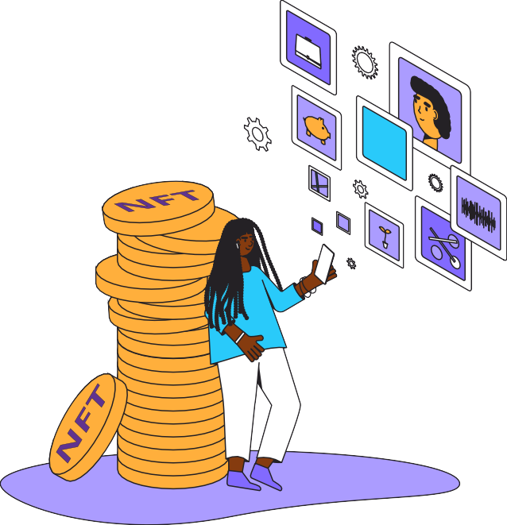



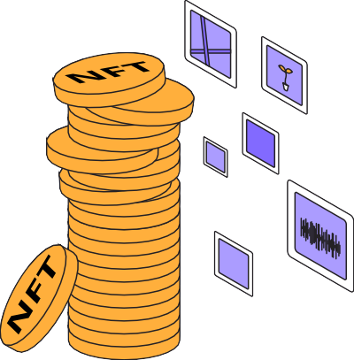


Problem Statement
On seen on the rising of the concept of NFTs, there is a need of building a marketplace where one could mint their own collection and list and buy the NFTs as well using the most widely used cryptocurrency wallet that is Metamask for the easily access to a larger section of society. It will be based on the Ethereum chain which is decentralized and open-source blockchain.

Slide 5



Scope & Feasibility
Platform where one can view different NFTs
Enter New & International Markets
Easily send and buy the NFTs
Safely performing the transaction for the NFTs

Slide 6
B
Technologies Used
Backend
Sanity io is the Backend technology used will provide the real-time database and will be supported by third web.
Frontend
Next js, a framework of React which we used in the frontend section using Tailwind CSS for the style.
F
C
Chain
The chain on which the entire marketplace is built is the Ethereum.
Wallet
Metamask is the wallet used for the authentication. .
W

Slide 7
Literature Review
NFT Marketplace Design and Market Intelligence | The Evolution of Non fungible Tokens: Complexity and Novelty of NFT Use-Cases | A Block-chain Based Decentralized Computing And NFT Infrastructure For Game Networks
NFT Marketplace Design
and Market Intelligence
The paper was published in 2022 by Pavel Kireyev. The research paper tells us that how market intelligence platforms have emerged to track summary statistics about pricing and sales activity across different NFT collections. The listing and realized sale price ratios between rare and common assets shrink, making the market appear more homogeneous.
The Evolution of
Nonfungible Tokens
The paper was published in 2022 by Andrew Park, Jan Kietzmann , Leyland Pitt and Amir Dabirian. They examined the emergence of NFTs, from their technical origins, the introduction of blockchain technologies and the first token-based collectibles that led to modern day NFT products.
A Blockchain Based Decentralized
Computing And NFT Infrastructure For Game Networks
The paper was published in 202 by Koushik Bhargav Muthe, Khushboo Sharma and Karthik Epperla Nagendra Sri. The motivation behind this research is to create a decentralized computation and token management infrastructure for game networks. This paper focuses on using Ethereum Blockchain, IPFS and ERC - Ethereum Request for Comment 1155 architecture to build a gaming- oriented public decentralized network.

Slide 8











Proposed Diagram
01
03
Building a home page
that will help to access the
different section of
marketplace easily
Authentication via the Meta mask in order to buy and sell the NFTs and updating the data on real-time basis.
02
04
Building a section where one could mint their own NFTs as well as see their collection.
Deploying the app using vercel so that
anyone and easily access and use it and becomes useful on real-time.
STAGE

Slide 9


References
1
https://www.researchgate.net/publication/359369351_How
_To_Build_NFT_Marketplace_from_Scratch_NFT_Mark etplace_Development
2
https://www.codica.com/blog/how-to-create-nft-marketplace/
3
4
https://www.finextra.com/blogposting/21905/a-guide-to-creating-nft-marketplaces
https://opengeekslab.com/blog/nft-marketplace- development/

Slide 10
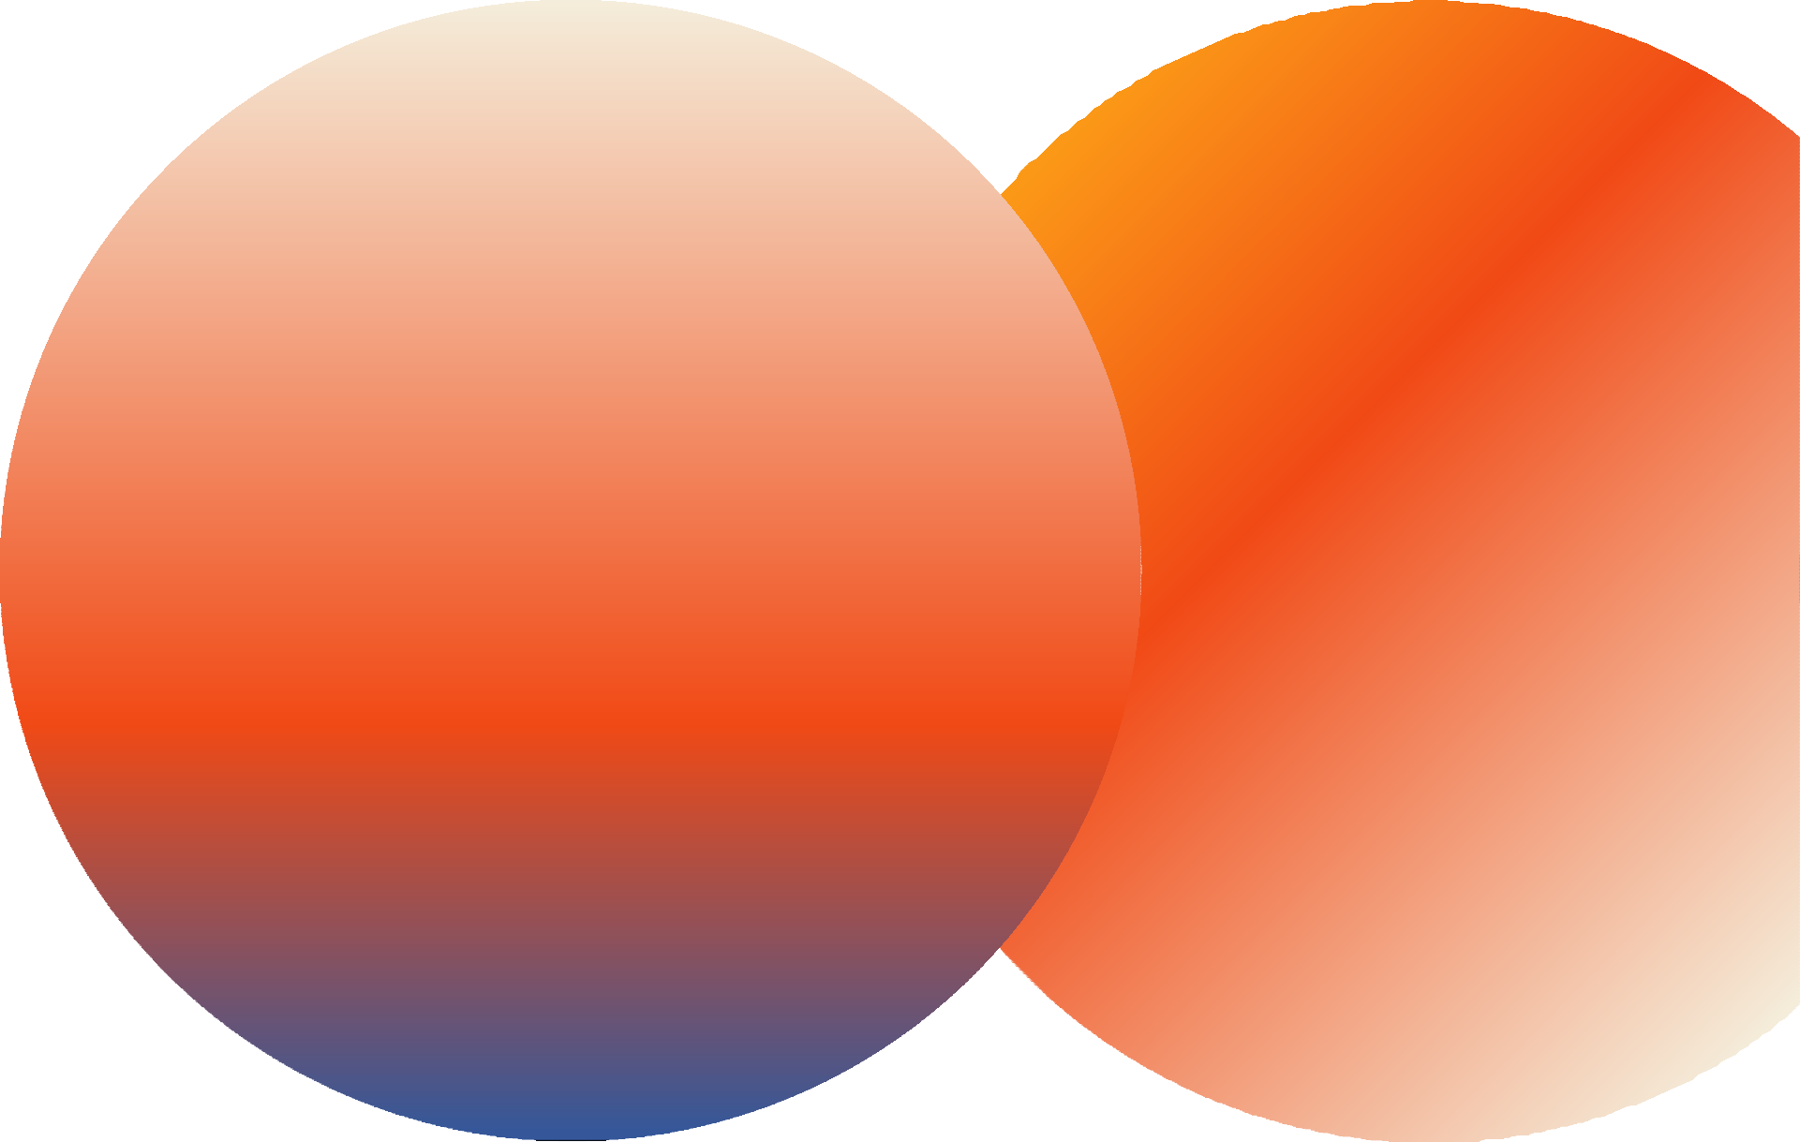
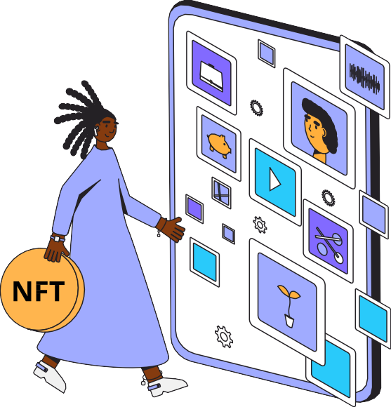
Thank you!
End

